Slide 1




NEXT GEN EMPLOYABILITY PROGRAM
Creating a future-ready workforce
Team Members
College Name
Student Name :P . Jenifer
Student ID : au951221104016
JP College Of Engineering

Slide 2

CAPSTONE PROJECT SHOWCASE
Project Title
Voting Web Application using Django Framework
Abstract | Problem Statement | Project Overview | Proposed Solution | Technology Used | Modelling & Results | Conclusion

Slide 3
Abstract
A voting web application using Django would be a platform where users can participate in various types of voting processes online. Users can create polls, vote on existing polls, view results, and potentially engage in discussions related to the topics of the polls. The application would likely include features such as user authentication, allowing only registered users to vote, and ensuring the security and integrity of the voting process. Overall, it provides a convenient and efficient way for users to engage in democratic decision-making or opinion gathering online.
Source :

Slide 4
Problem Statement
The problem statement for a voting web application using Django would involve addressing the need for a secure, user-friendly platform for conducting online polls and elections. This includes ensuring user authentication, preventing fraud or manipulation of votes, and providing an intuitive interface for both administrators and participants. The goal is to create a reliable and accessible platform that fosters democratic participation and decision-making in a digital environment.
Source :

Slide 5
Project Overview
A voting web application using Django aims to provide a robust platform for conducting online polls and elections. It will allow users to create, manage, and participate in various types of voting processes securely. The application will include features such as user authentication, ensuring only authorized users can vote, and implementing measures to prevent fraud or manipulation of votes. Additionally, it will offer an intuitive interface for administrators to manage polls and for participants to cast their votes conveniently. Overall, the project seeks to facilitate democratic engagement and decision-making in a digital format.
Project setup
App creation
Database models
Admin interfaces
User authentication
Poll creation
Voting and results display
Front end design and URL routing
Testing and deployment

Slide 6
Proposed Solution
The proposed solution for the voting web application using Django involves creating a secure and user-friendly platform where users can participate in online polls and elections. The solution will include robust user authentication mechanisms to ensure the integrity of the voting process. It will provide an intuitive interface for creating, managing, and participating in polls, with features such as real-time vote tracking and result visualization. Additionally, the solution will implement measures to prevent fraud and ensure the confidentiality of votes. Overall, it aims to offer a reliable and accessible platform for democratic engagement in a digital environment.
Source :

Slide 7
Advantages:
Django's ORM simplifies database interactions by abstracting away the need to write SQL queries directly, making database operations more intuitive and less error-prone.
Django is versatile and can be used to build a wide range of web applications, from simple blogs to complex e-commerce platforms, including voting systems.
Security: Django provides built-in security features that help protect against common web vulnerabilities, ensuring the integrity of the voting process.
Scalability: Django's scalability allows the application to handle large numbers of users and votes efficiently, making it suitable for various scales of elections or polls.
Source :

Slide 8
Disadvantages
Complexity: Django, while powerful, has a learning curve, especially for developers new to the framework. Building a robust voting application may require familiarity with Django's concepts and best practices.
Performance overhead: Django's ORM (Object-Relational Mapping) layer may introduce performance overhead, especially for complex queries or high-traffic applications. Careful optimization may be needed to ensure optimal performance.
Security vulnerabilities: While Django provides built-in security features, improper implementation or configuration could lead to security vulnerabilities. Regular updates and security audits are necessary to mitigate risks.
Performance:While Django is capable of handling high traffic and scaling horizontally, it may not be as performant as some other frameworks or languages in certain use cases. Careful optimization and tuning may be required for applications with particularly demanding performance requirements.
Source :

Slide 9




Technology Used
Front-end
Back-end
Source :

Slide 10
Modelling & Results
In developing a voting application using Django, meticulous attention is directed towards both modeling the underlying data structure and effectively presenting the voting results to users.
Through Django's model system, the application's data architecture is meticulously crafted, typically featuring models like Question and Choice to represent the polls and available choices.
Once users have participated in the voting process, conveying the results to them becomes paramount.
Leveraging Django's templating system, the application dynamically generates HTML templates that vividly present the voting outcomes in an intuitive and visually engaging manner.
Furthermore, the application may utilize charting libraries or custom visualization techniques to elucidate the distribution of votes across different options, offering users valuable insights into the voting process's outcome.
Source :

Slide 11
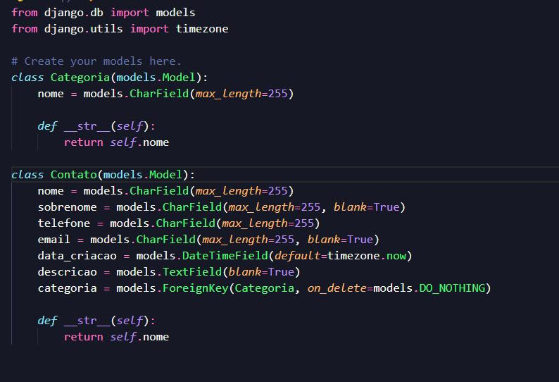
Homepage

Slide 12
About-Us-Page
1.Credibility: The "About Us" page establishes credibility by providing informationabout the organization's history, mission, and team members .
2.Mission and Values: It communicates the organization's mission, values, and objectivesin promoting democratic participation and decision-making.
3. Community Engagement: The page showcases the organization's commitment tocommunity engagement and empowerment through the voting process, inspiring active participation.
4. Contact Information: Users can easily reach out with questions, feedback, or inquiriesabout the voting application through the contact information provided on the page.

Slide 13
Service-Page
Header Section
Introduction section
User Services
Administrator Services
Organizational Services
Technical Services
Consulting Services
Call to Action Services

Slide 14
Departments-Page
Header Section
● Introduction Section
● Department Listings
● Department Details
● Key Personnel
● Collaboration Opportunities
● Footer Section

Slide 15
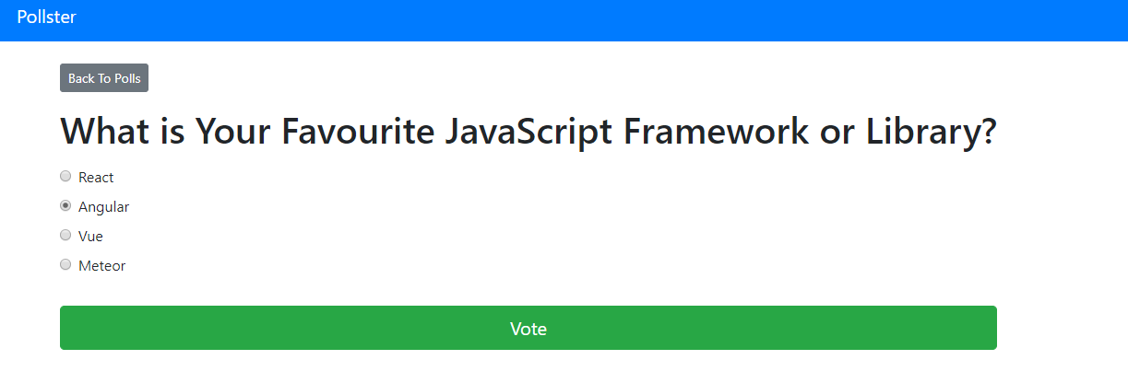
Blog-Page

Slide 16
Future Enhancements:
Utilize machine learning algorithms to analyze voting data, predict future trends, and provide personalized recommendations for users based on their voting history and preferences
Extend the voting application's reach by developing native mobile apps for iOS and Android platforms, offering a seamless and optimized experience for mobile users.
Explore integrating blockchain technology to enhance the transparency, security, and integrity of the voting process, ensuring that votes are immutable and tamper-proof.
Implement comprehensive reporting functionalities for administrators to generate detailed reports on voting patterns, demographics, and trends. This could include visualizations such as charts and graphs.

Slide 17
Conclusion
In conclusion, using Django for a voting web application offers a robust and reliable framework for implementing democratic processes online. Despite potential complexities and challenges, Django provides numerous advantages, including security, scalability, customization, and community support. By leveraging Django's features and ecosystem, developers can create user-friendly and secure voting platforms that facilitate democratic engagement and decision-making in a digital environment. With careful planning, implementation, and maintenance, a voting web application using Django can effectively serve its purpose while providing a seamless and intuitive experience for administrators and participants alike.
Source :

Slide 18
Thank You!
Notes:
Thank You !!

